Slide 1
Rollerball
Group: String Cheese
Members: Chris Schaffer, Tim Stroup, Ya-Hsin Cheng, Meetkumar Savaliya, Sirius Chen

Slide 2
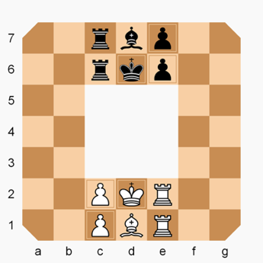
Rollerball Rules
The Board
7×7 squares with the 3×3 blanks in the center
The Pieces
Move in clockwise direction
1 King - moves any direction
1 Bishop - moves diagonally
2 Rooks - moves straight
2 Pawns - moves straight or diagonally forward
How to win
Checkmate the enemy king
Travel own king clockwise direction to the start position of the enemy king
Rebound off

Slide 3
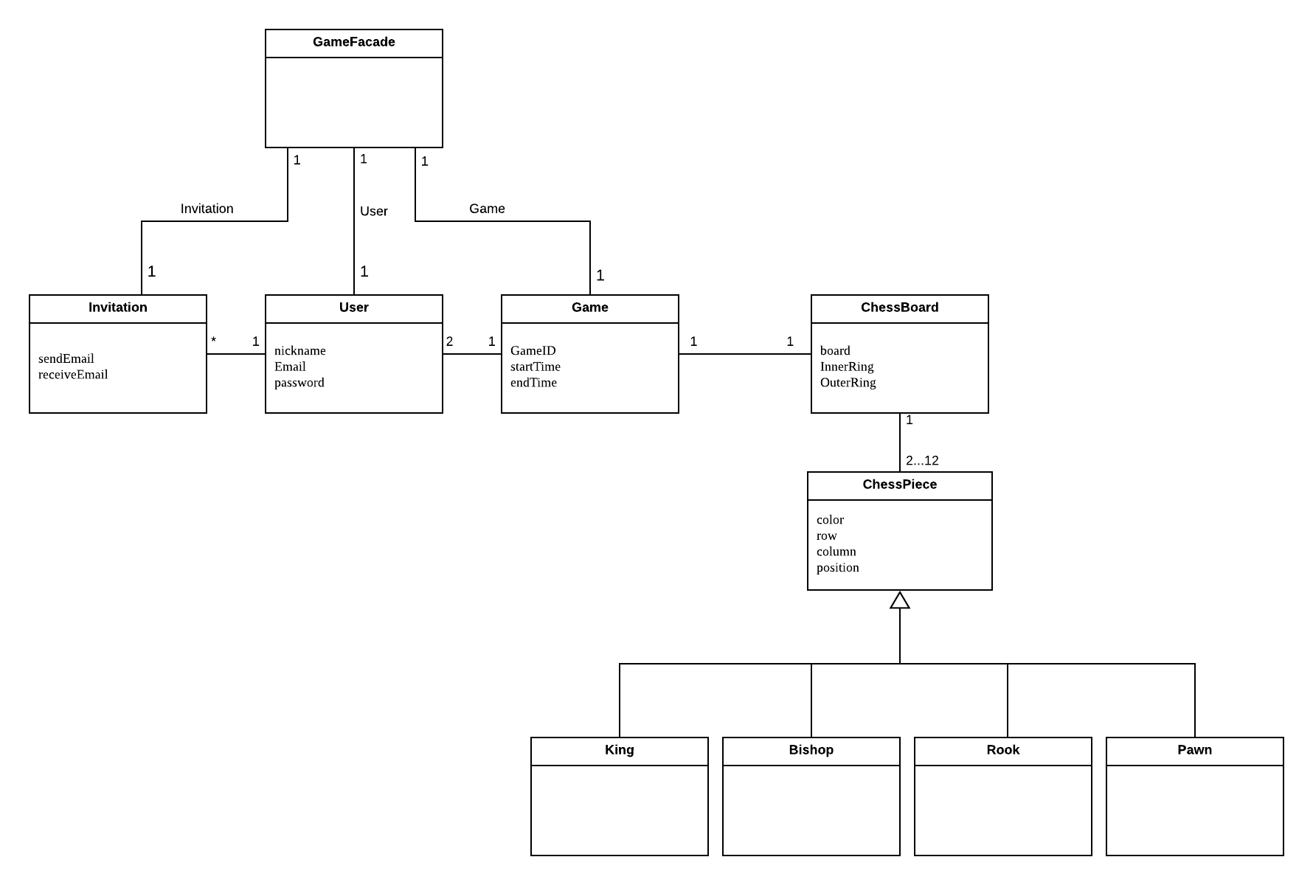
Domain Model Documents
GameFacade :
The game facade includes the game, user, and invitation, connect to the
UI. Each click from the UI, will pass the action through the game facade to the game, user, or invitation.
Invitation :
A user may send an invitation to another user as well as receive an invitation from another user to play a game. A user may send multiple invitations to multiple users to play a game.
User :
A person registered to play the game. They may send invitations to other users to play one or more games at a time.
ChessPiece :
The game is played with different pieces; each with unique movements and rules. Each player has either six white or six black pieces that include two pawns, one king, one bishop and two rooks.
Game :
A game consists of two users who take turns moving their pieces around the board.
ChessBoard :
The board is the combination of spaces that a piece may move and the boundaries of the game.

Slide 4
ChessBoard | The board is the combination of spaces that a piece may move and the boundaries of the game.
ChessPiece | The game is played with different pieces; each with unique movements and rules. Each player has either six white or six black pieces that include two pawns, one king, one bishop and two rooks.
Game | A game consists of two users who take turns moving their pieces around the board.
GameFacade | The game facade includes the game, user, and invitation, connect to the UI. Each click from the UI, will pass the action through the game facade to the game, user, or invitation.
Invitation | A user may send an invitation to another user as well as receive an invitation from another user to play a game. A user may send multiple invitations to multiple users to play a game.
User | A person registered to play the game. They may send invitations to other users to play one or more games at a time.

Slide 5
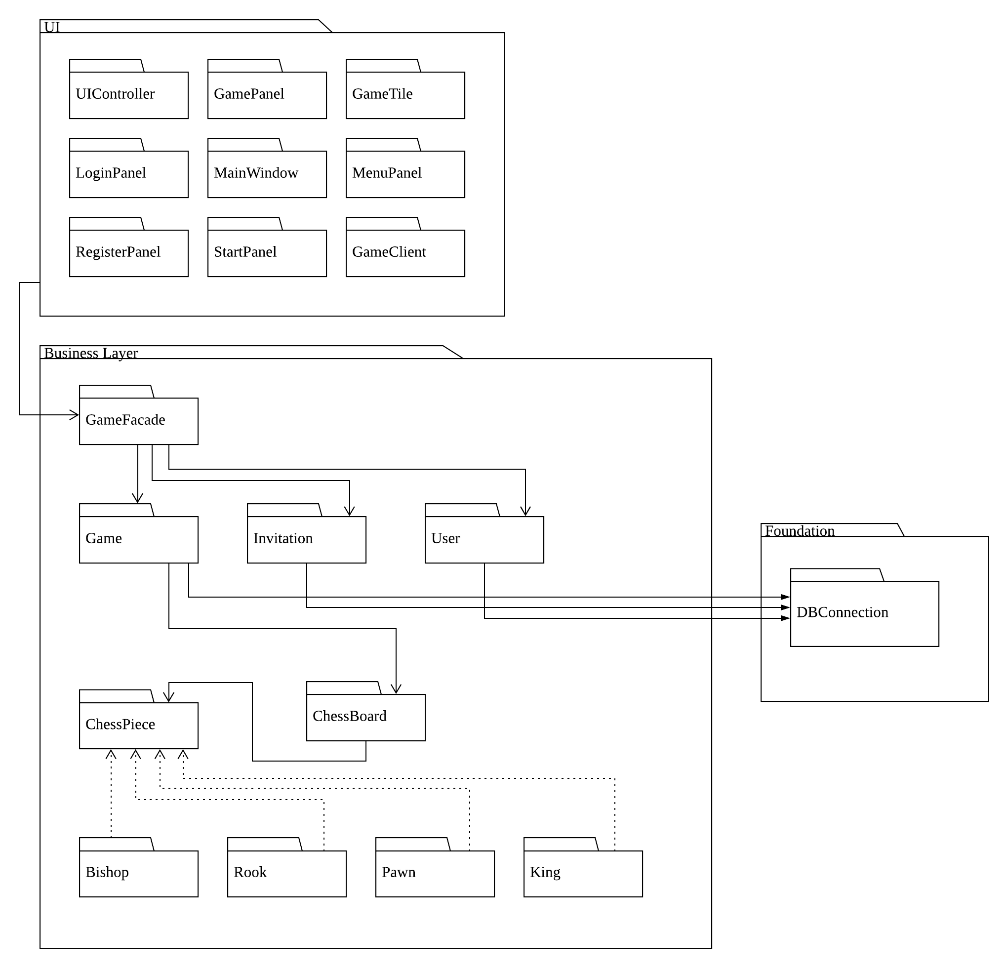
Package Diagram

Slide 6
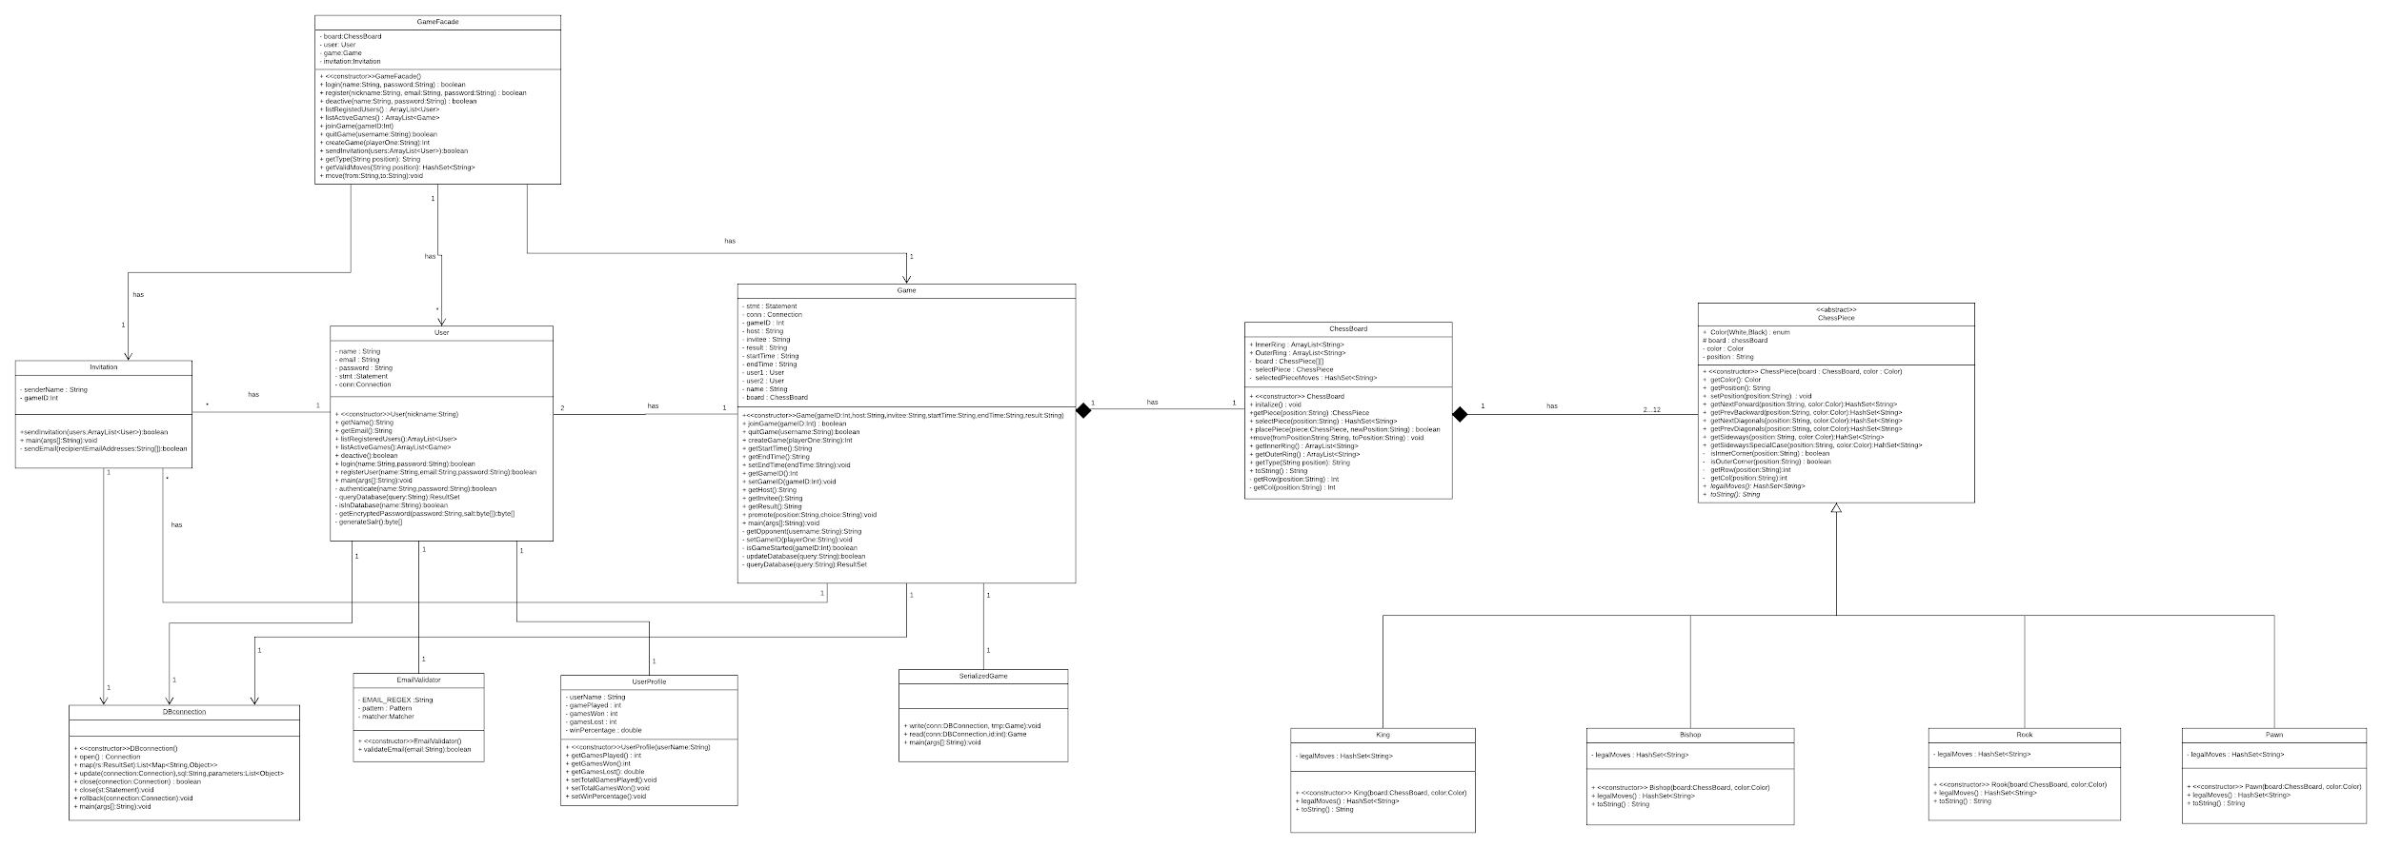
Class Diagram - Game

Slide 7
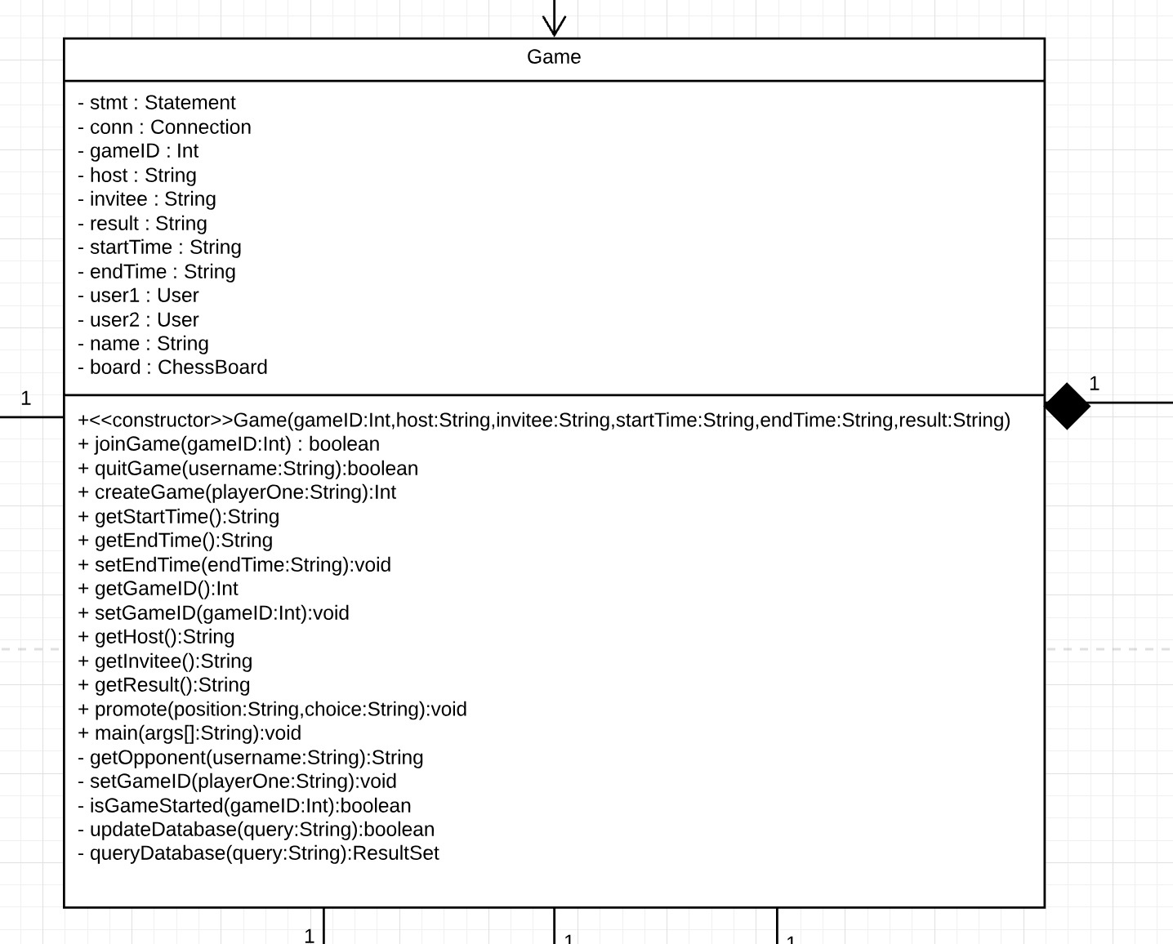
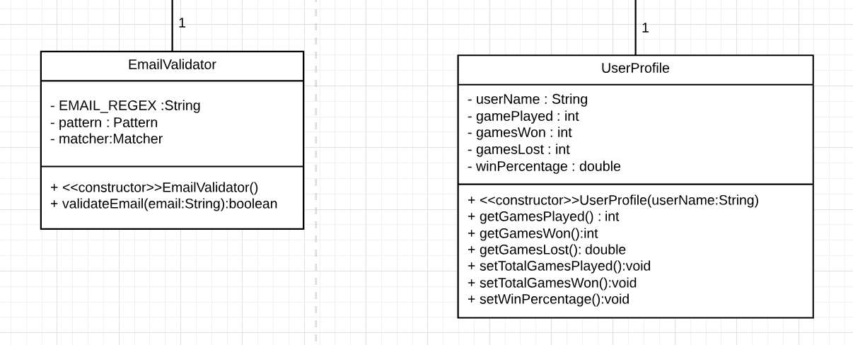
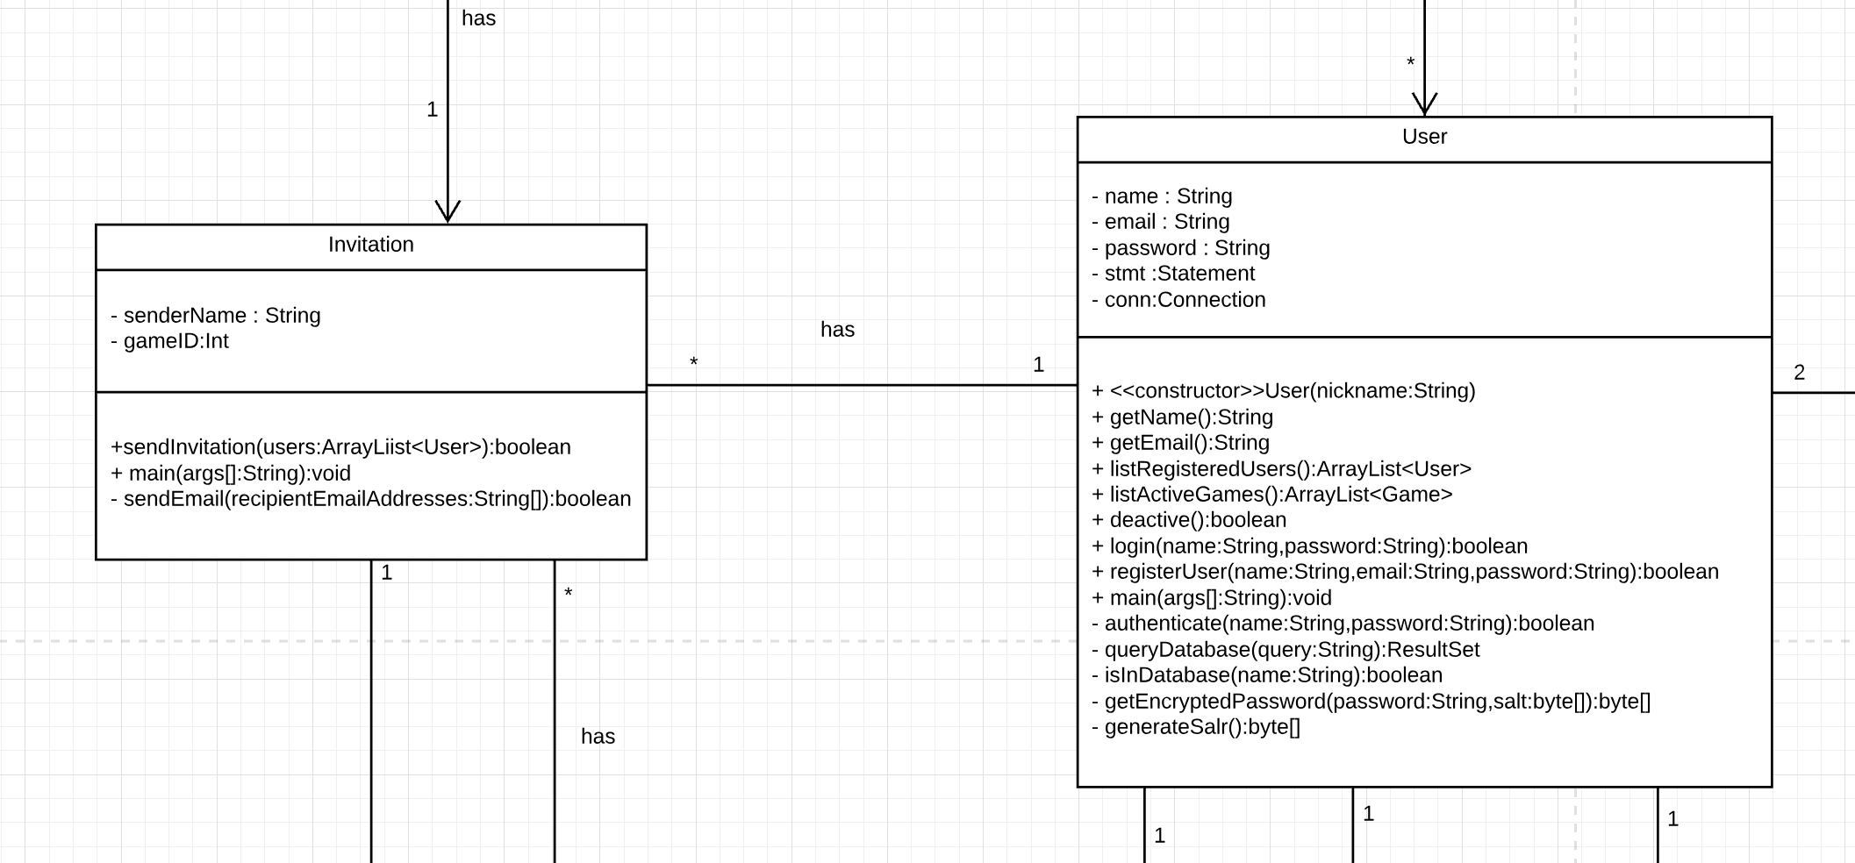
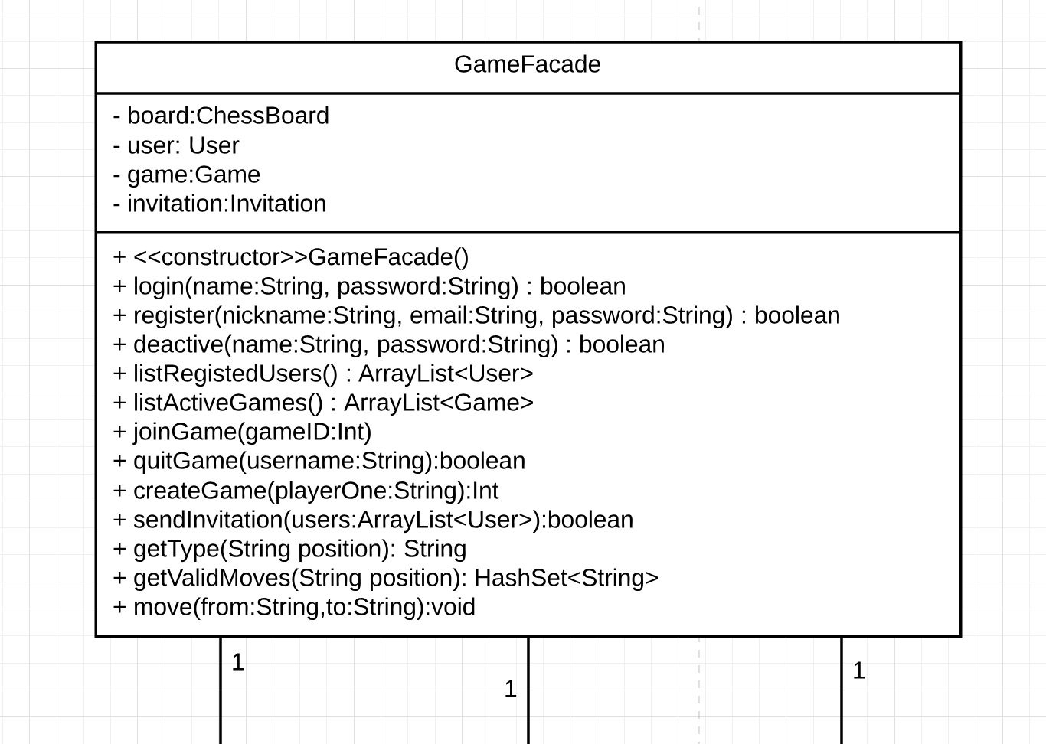
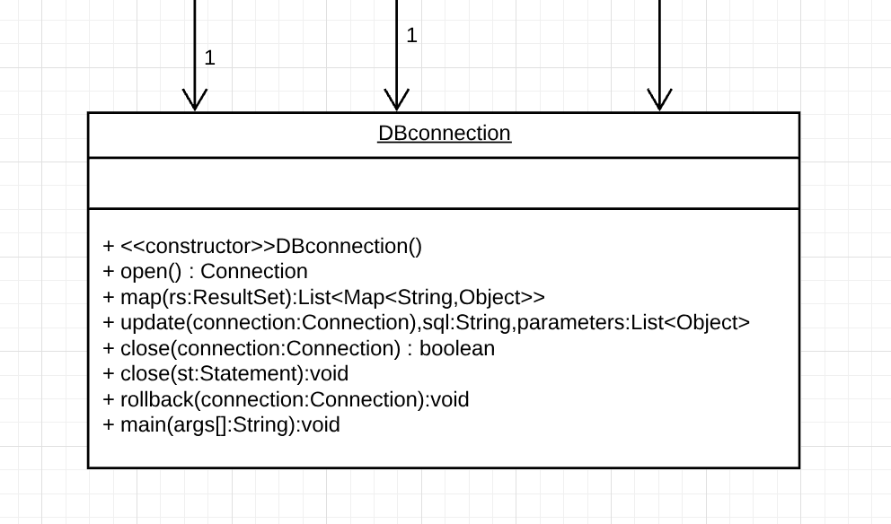
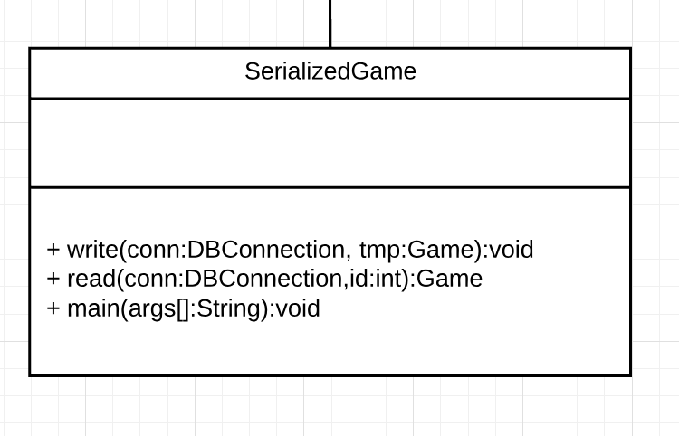

Slide 8
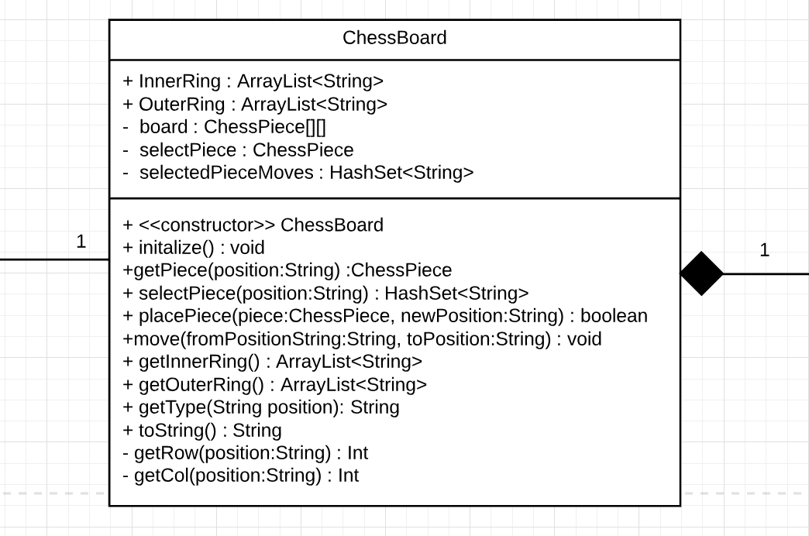
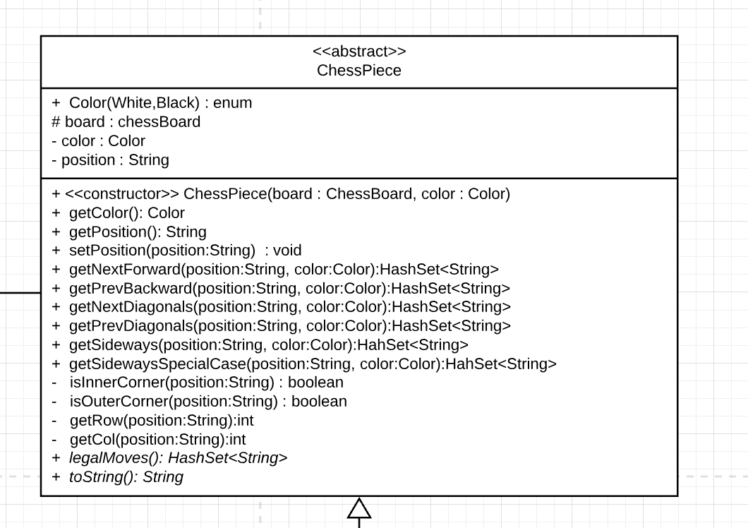
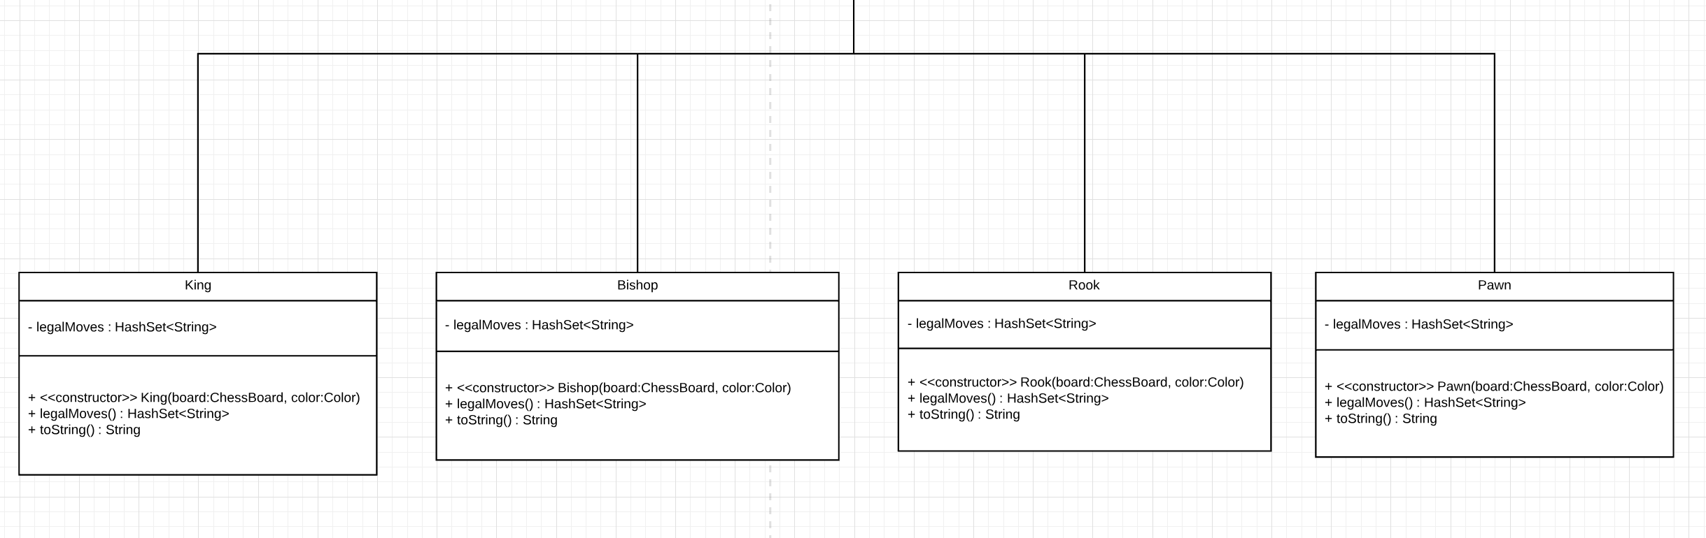

Slide 9
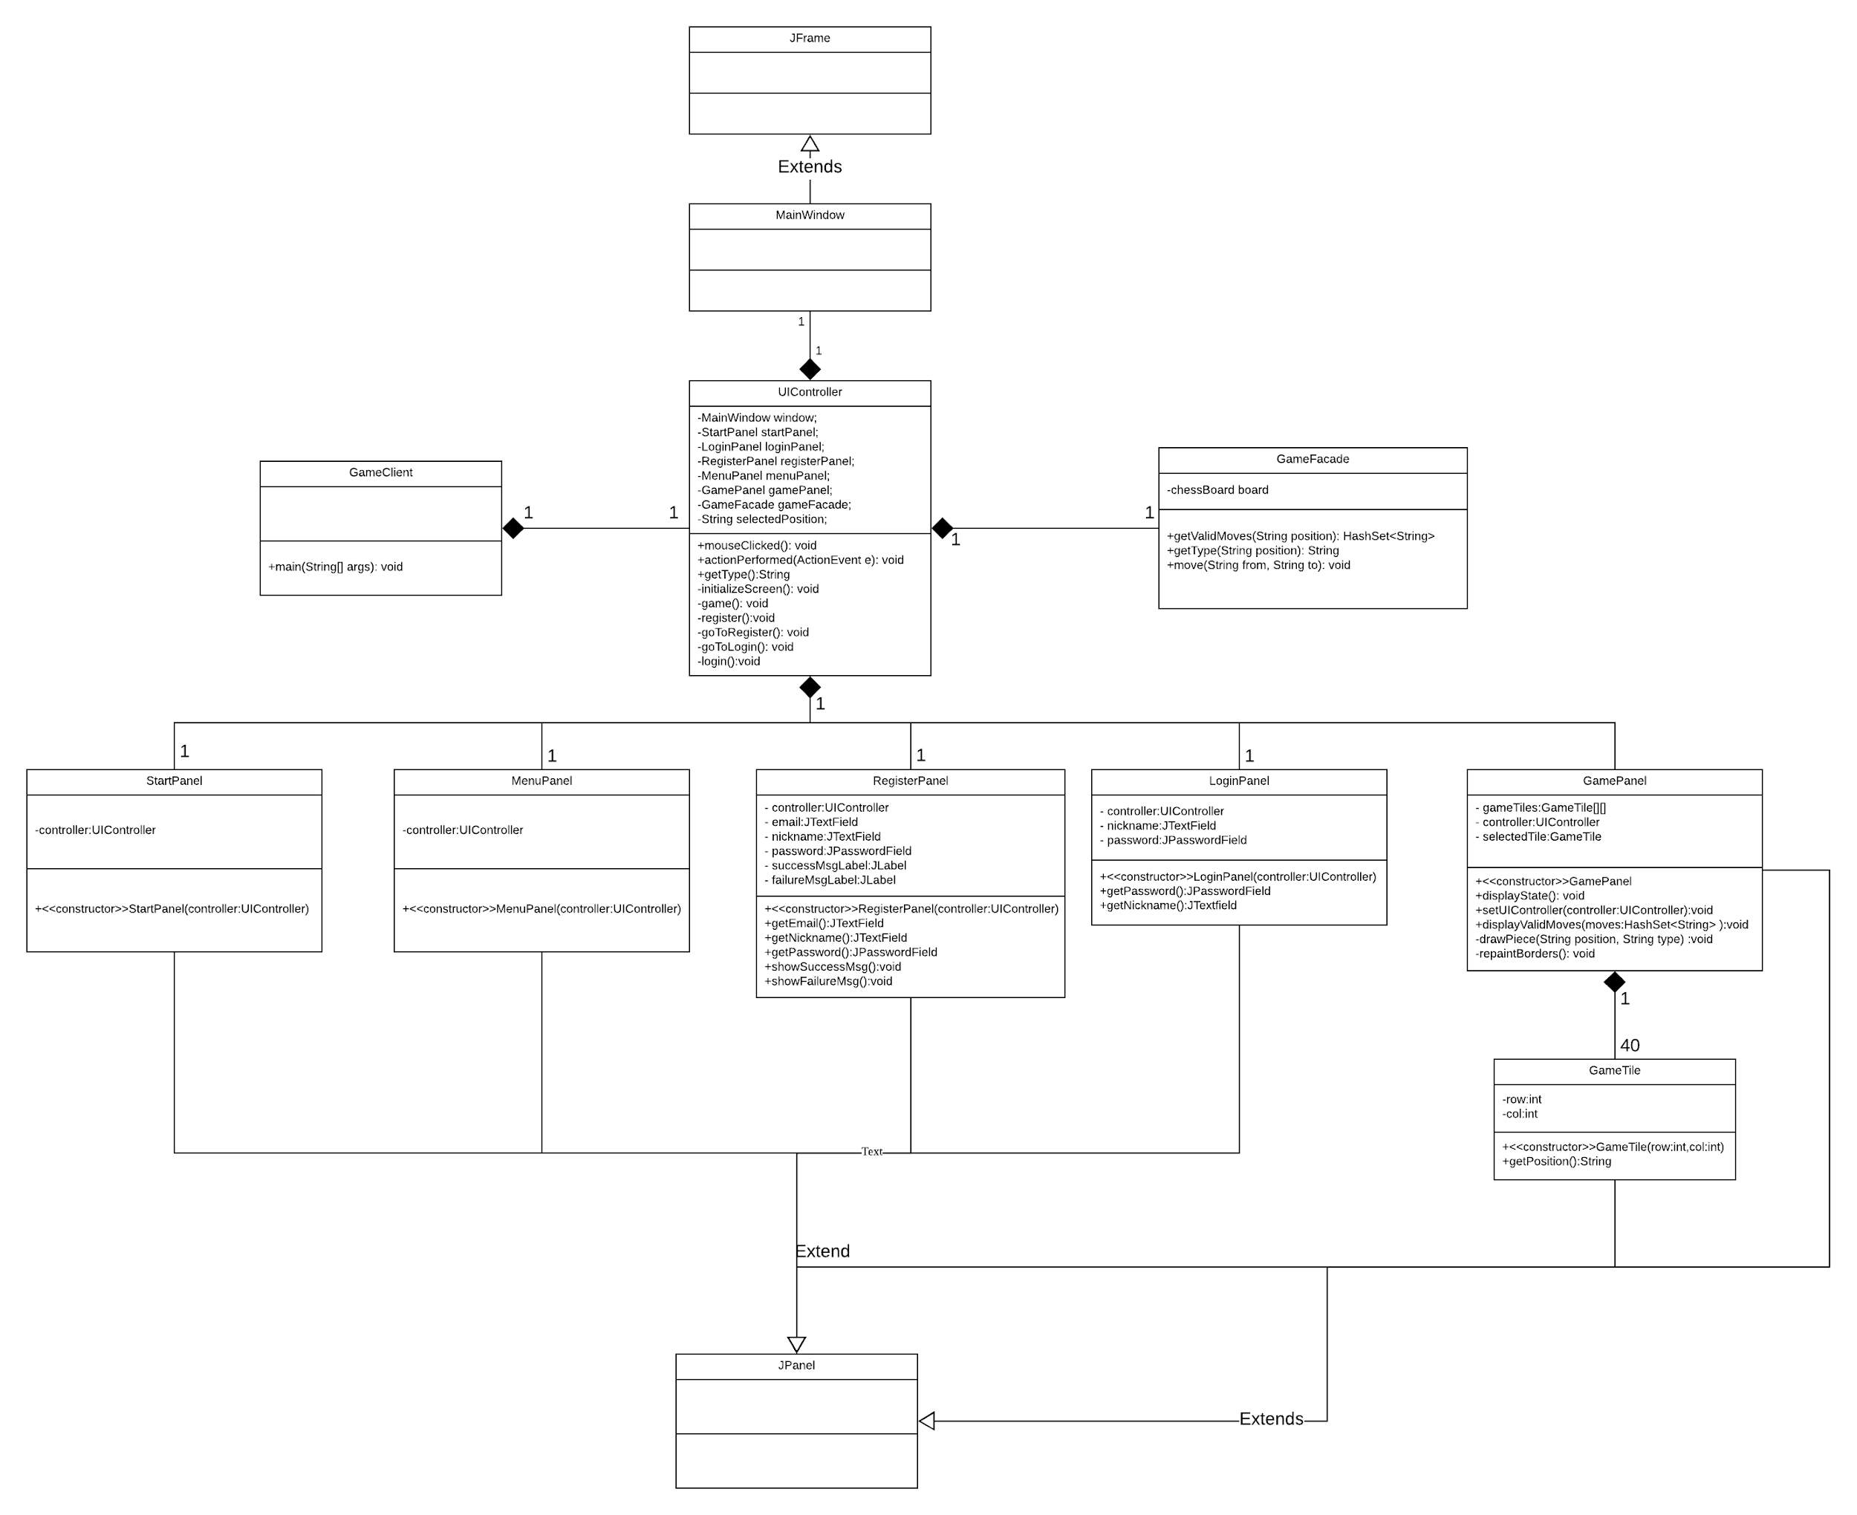
Class Diagram - UI

Slide 10
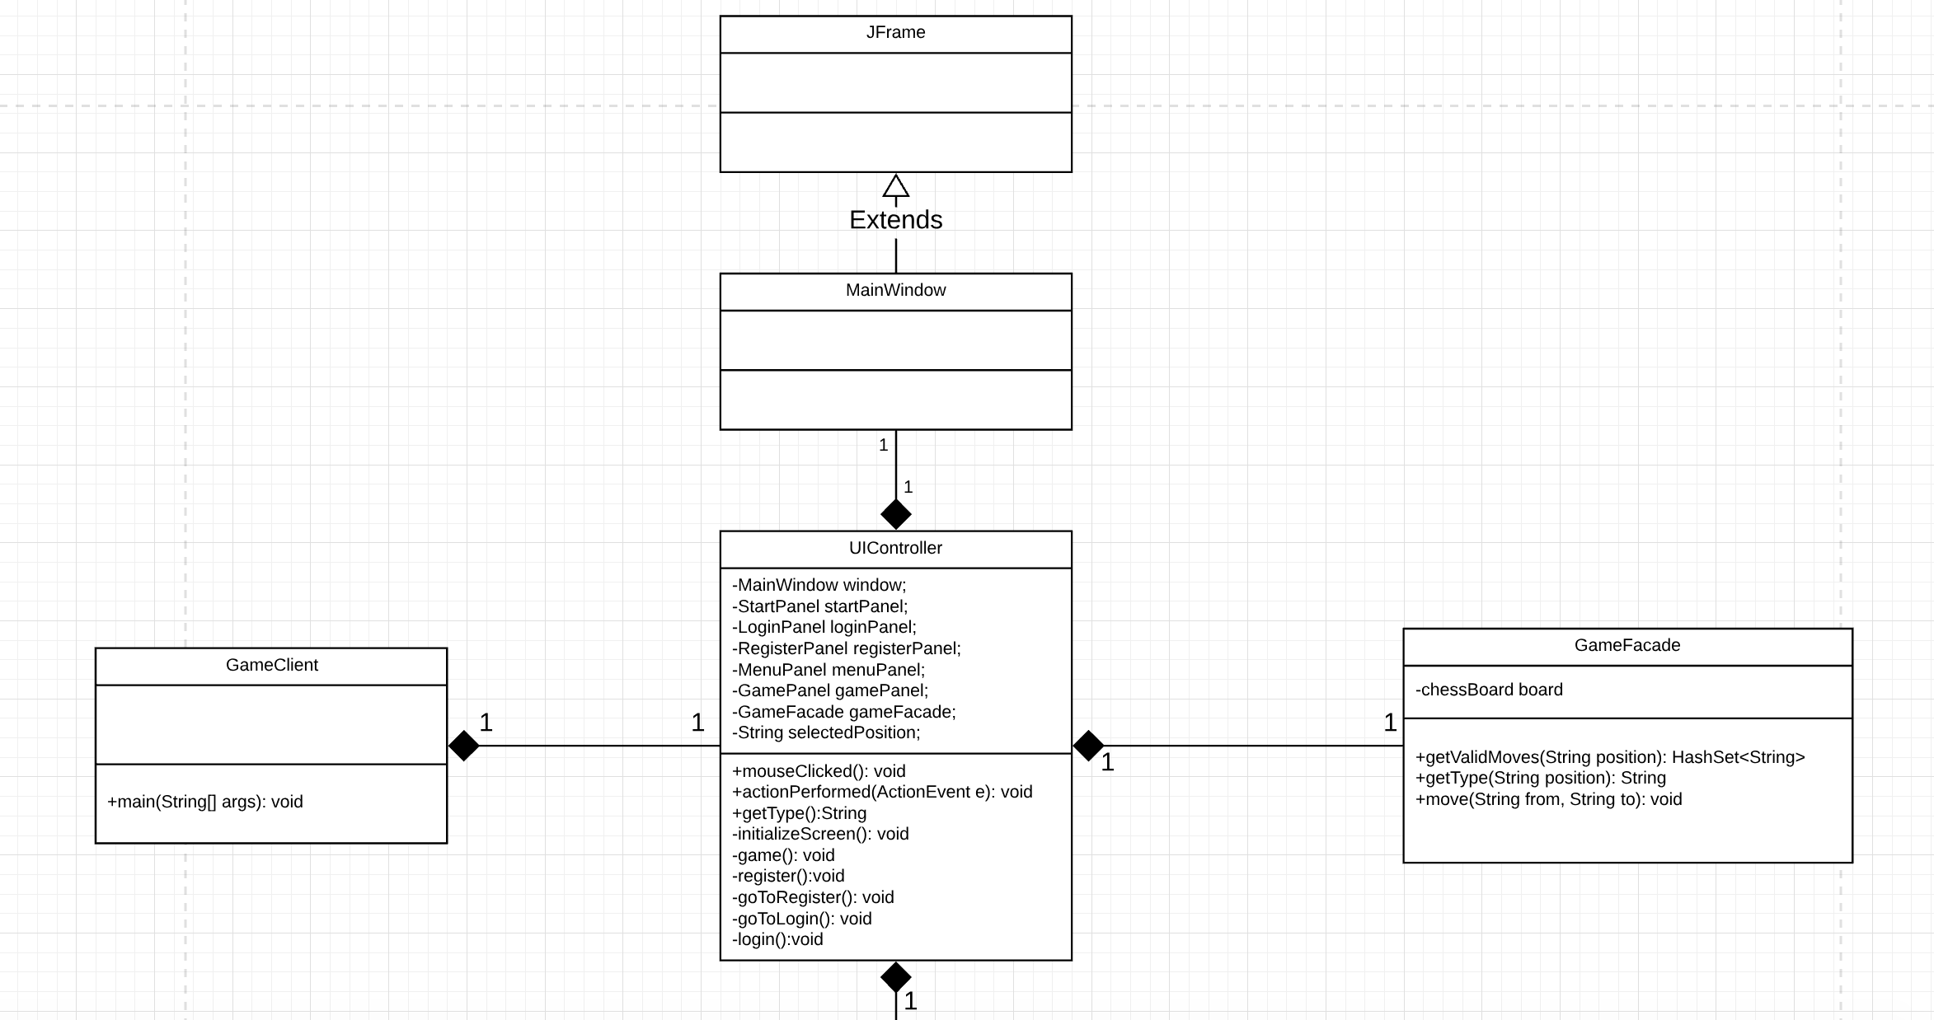
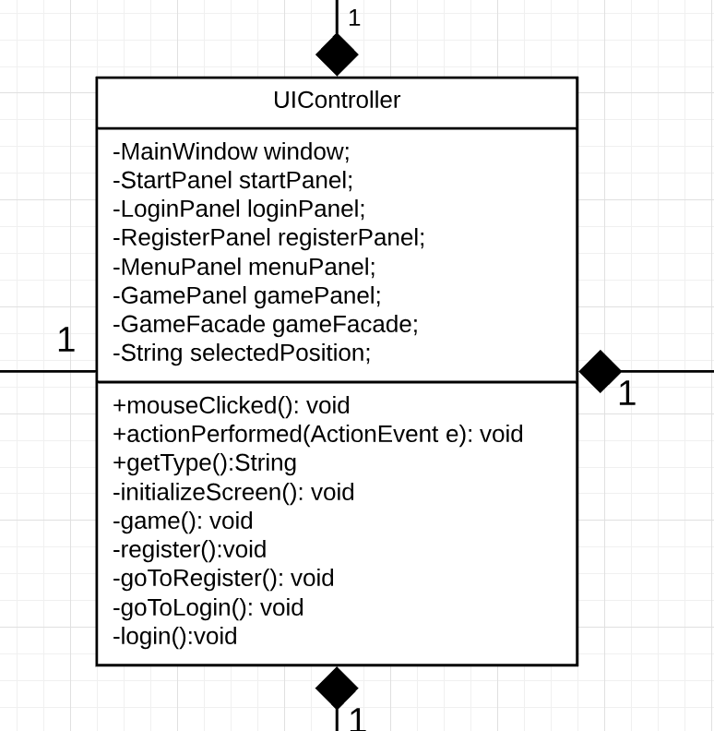

Slide 11
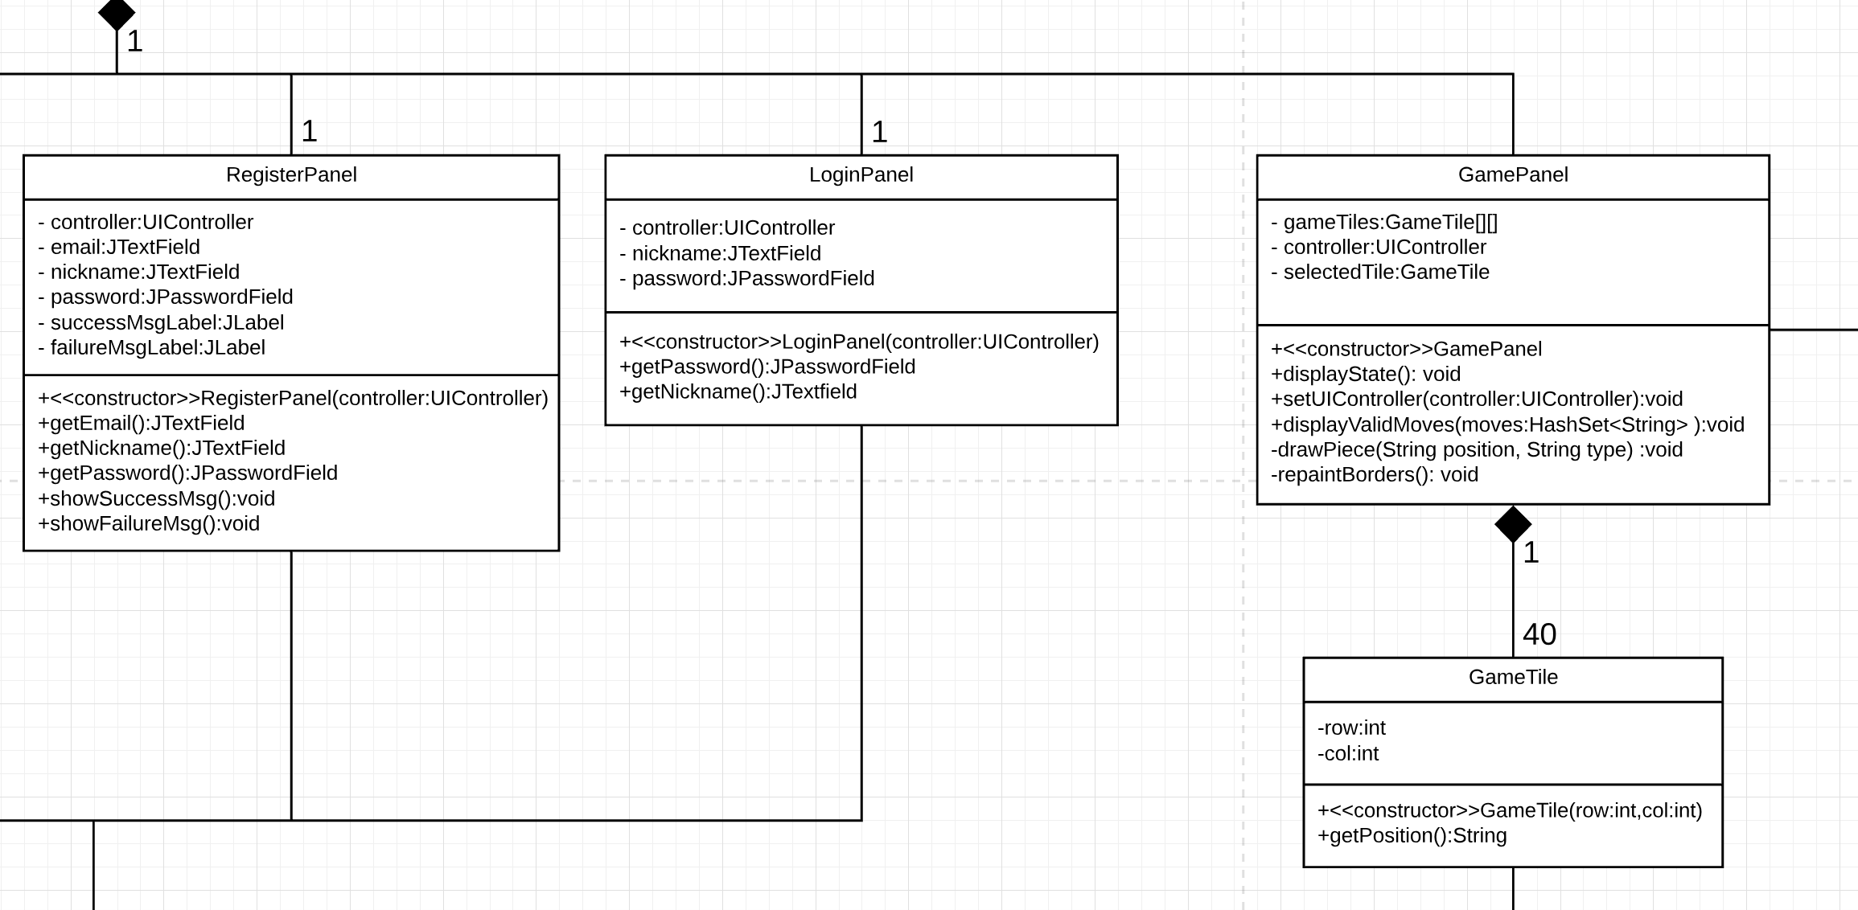

Slide 12
Sequence Diagrams
We decided to regenerate our sequence diagrams using an Intellij plugin called SequenceDiagram

Slide 13
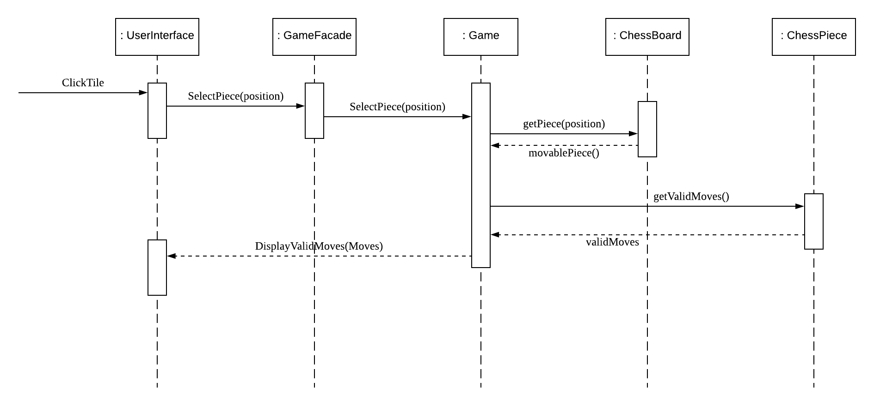
Old Take Turn Sequence Diagram: We decided to split this sequence diagram into two, Display Valid Moves and Make Move.

Slide 14
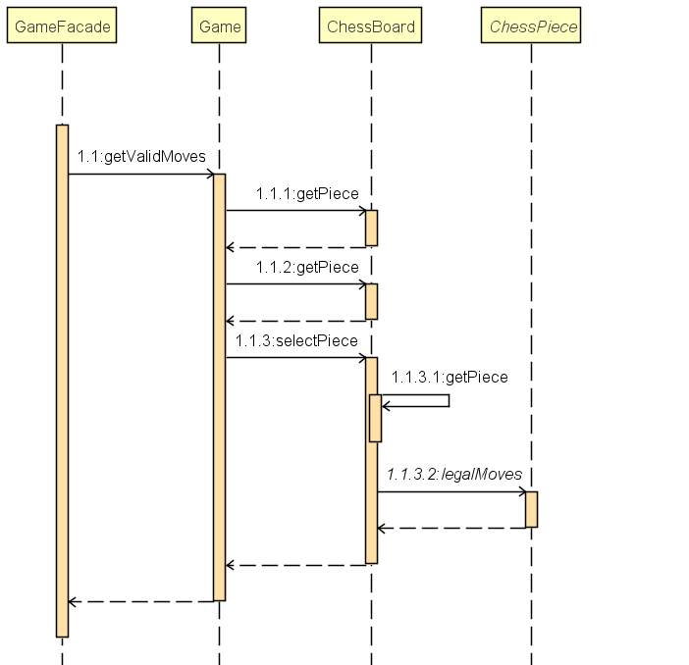
Display Valid Moves

Slide 15
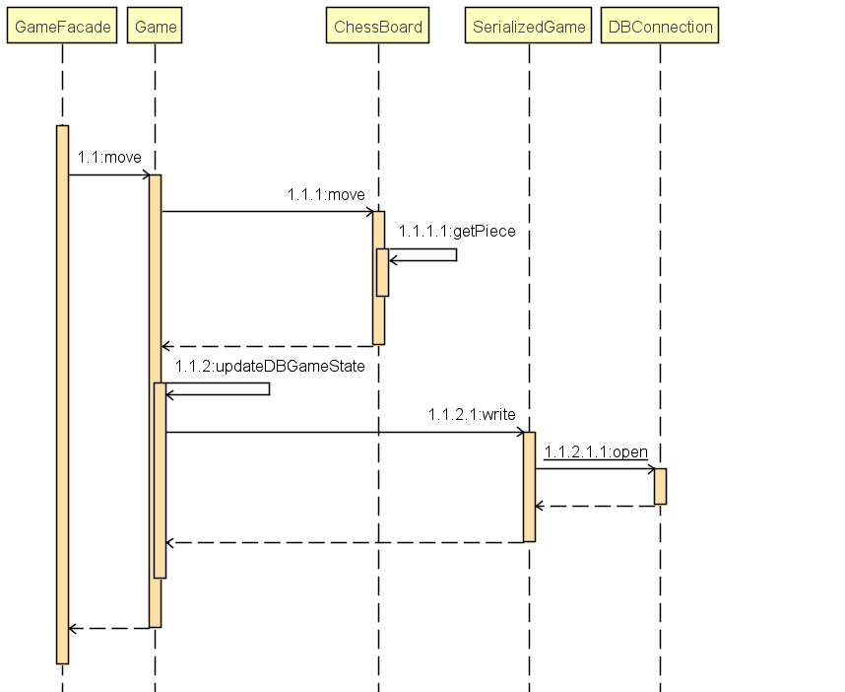
Make Move

Slide 16
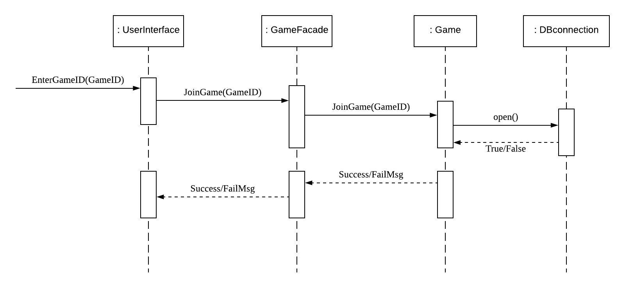
Old Join game Sequence Diagram

Slide 17
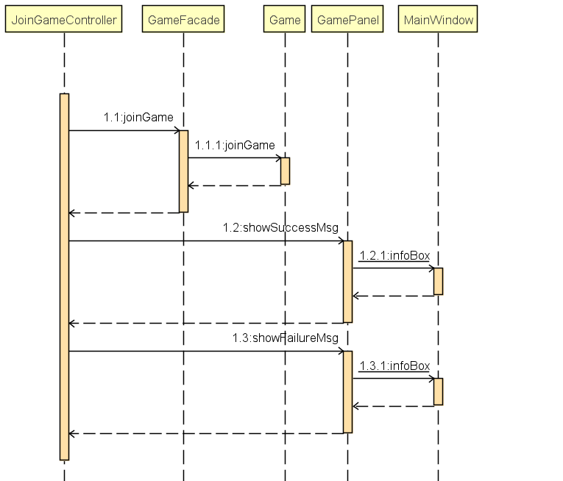
Join Game

Slide 18
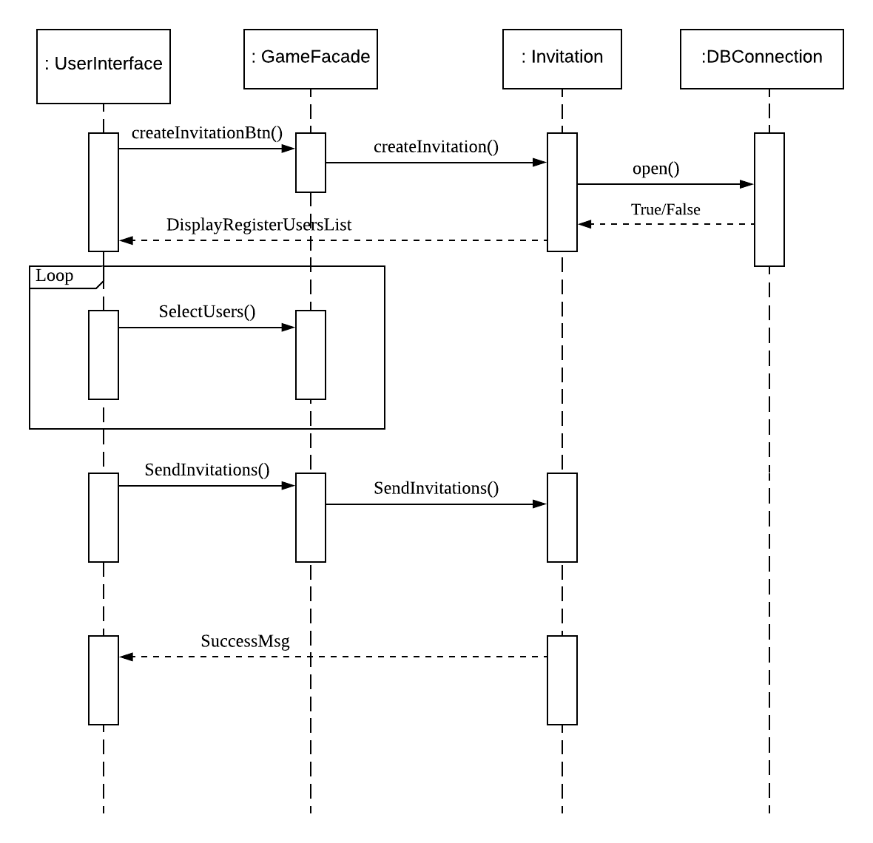
Old Send Invitations Sequence diagram

Slide 19
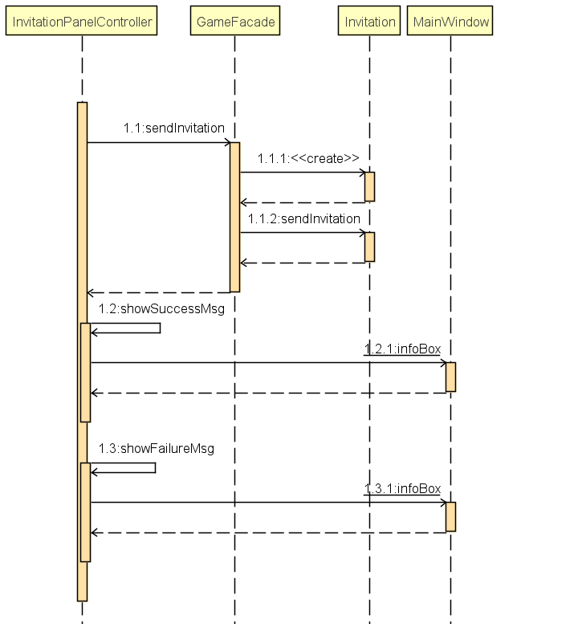
Send Invitations

Slide 20
Old Traceability Link Matrix
 | ChessBoard | ChessPiece | Game | Invitation | User | DBconnection
UC1-Register Account |  |  |  |  | X | X
UC2-Create Game |  |  | X |  |  | X
UC3-Create Invitation |  |  |  | X | X | X
UC4-Deactivate account |  |  |  |  | X | X
UC5-Join Game |  |  | X |  | X | X
UC6-View Profile |  |  |  |  | X | X
UC7-Log on |  |  |  |  | X | X
UC8-Quit game |  |  | X |  |  | X
UC9-List active games |  |  | X |  |  | X
UC10-Take Turn | X | X | X |  | X | X
UC11-Update Game State | X |  | X |  |  | X
UC12-Display Valid Moves | X | X | X

Slide 21
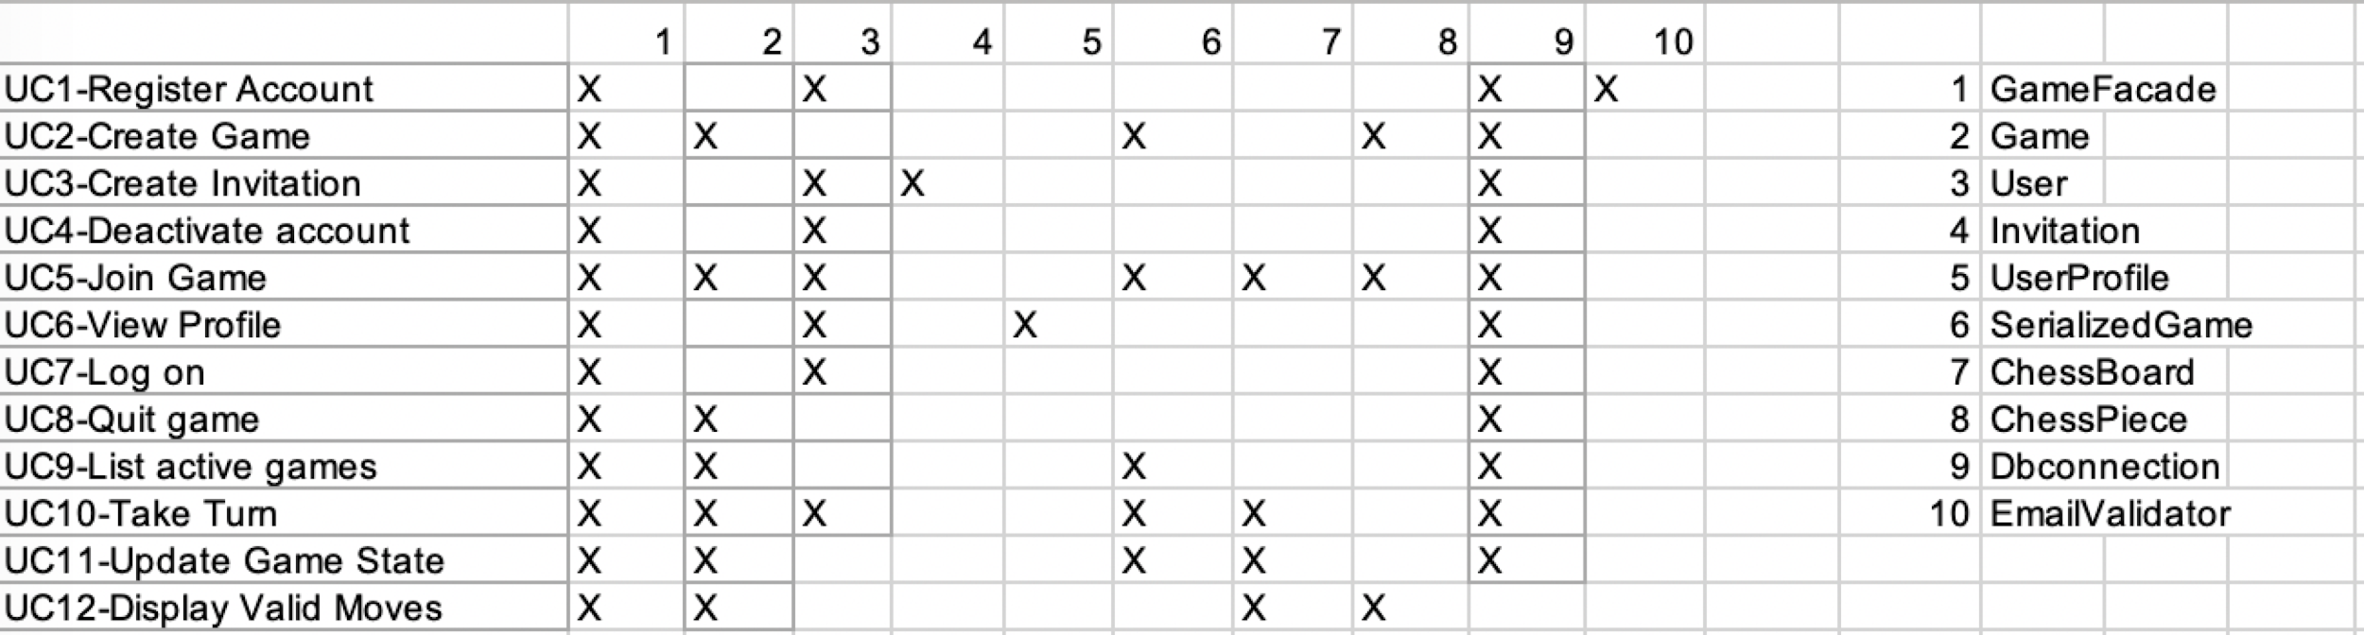
New Traceability Link Matrix

Slide 22
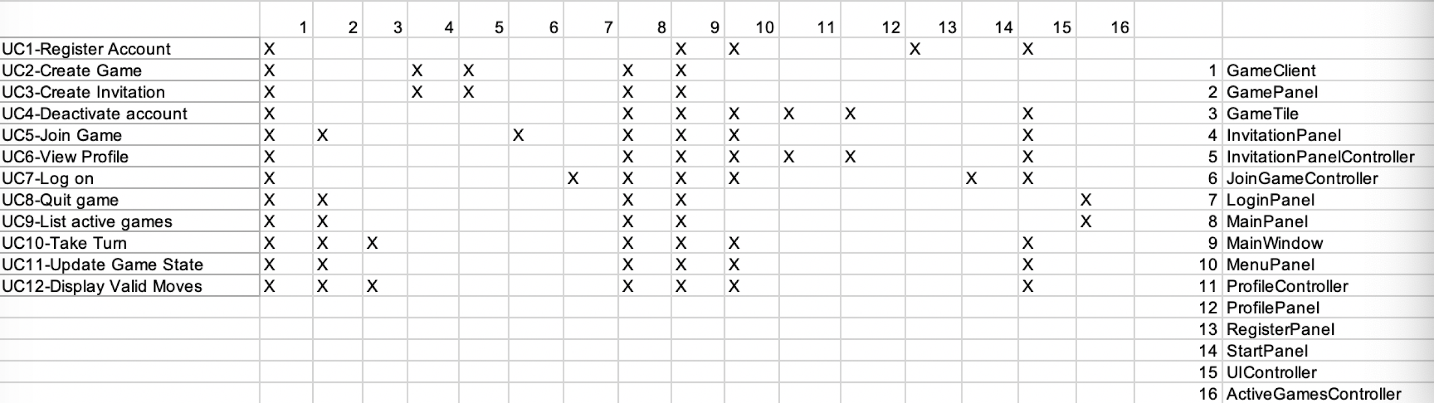

Slide 23
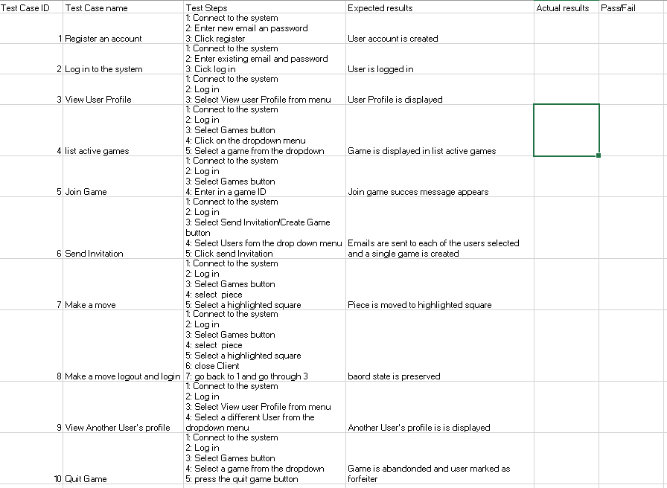

Slide 24
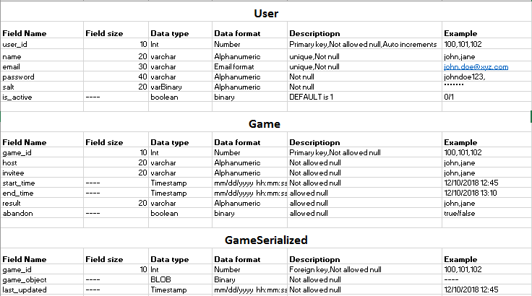
Data Dictionary

Slide 25
Challenges & Lessons Learned
Challenges:
Long Design period
Different levels of programming experience
Language and Cultural Barriers
Difficulty grasping entire System
Lessons Learned:
Communication is Key
Software Design is Difficult
Using the Swing Library
AWS
Observer Pattern

Slide 26
Technologies and Tools
Programming Language: Java
Programming Environment: IntelliJ IDEA
Testing: Travis Continuous Integration
Other: GitHub, AWS, Zenhub
Development Manual

Slide 27
Refactor
Integration Function:
Incorporate taketurn() into the move() to make the code more concise
Need more refactor

Slide 28
Thank you for listening
Q&A

